Slide 1
Catalyst Pet — Growth Report
Subscriber growth by year • Walmart 15 lb Original weekly trajectory
Generated September 22, 2026

Slide 2
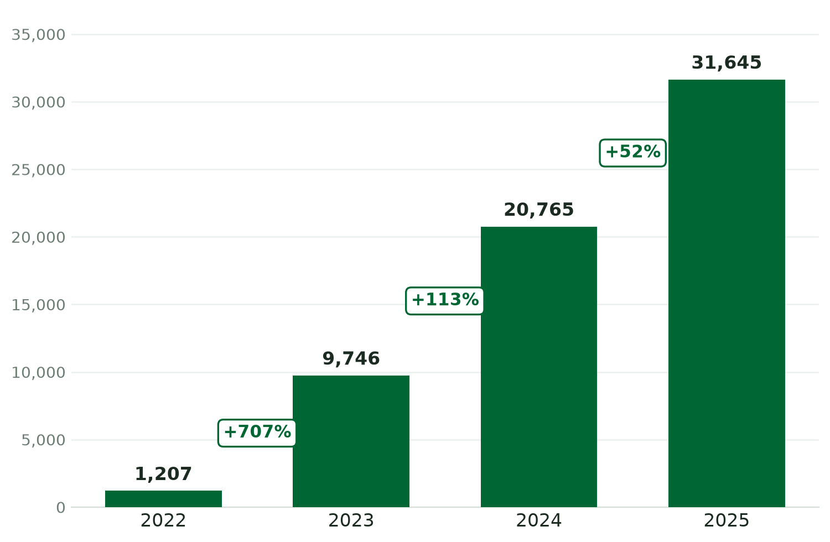
Subscriber Growth by Year
Active Shopify DTC subscriptions at year-end (excludes ~7,000 Chewy subscribers)
1,207 → 31,645
2022–2025 year-end
~197% CAGR

Slide 3
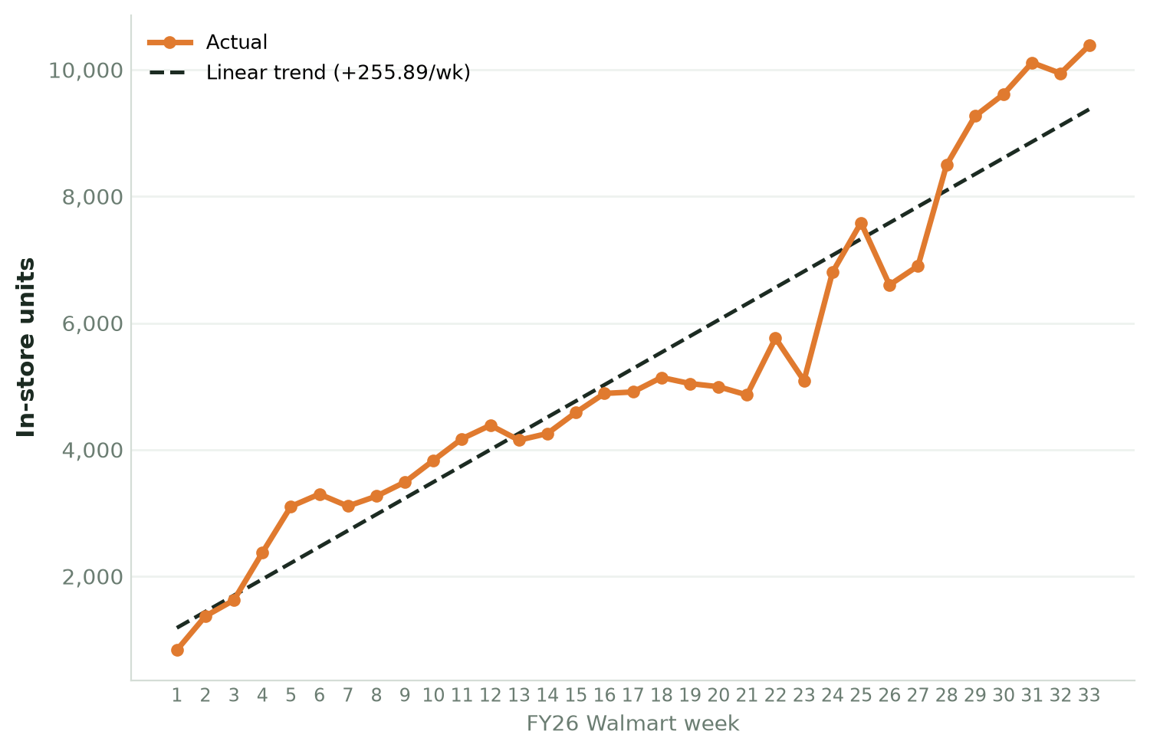
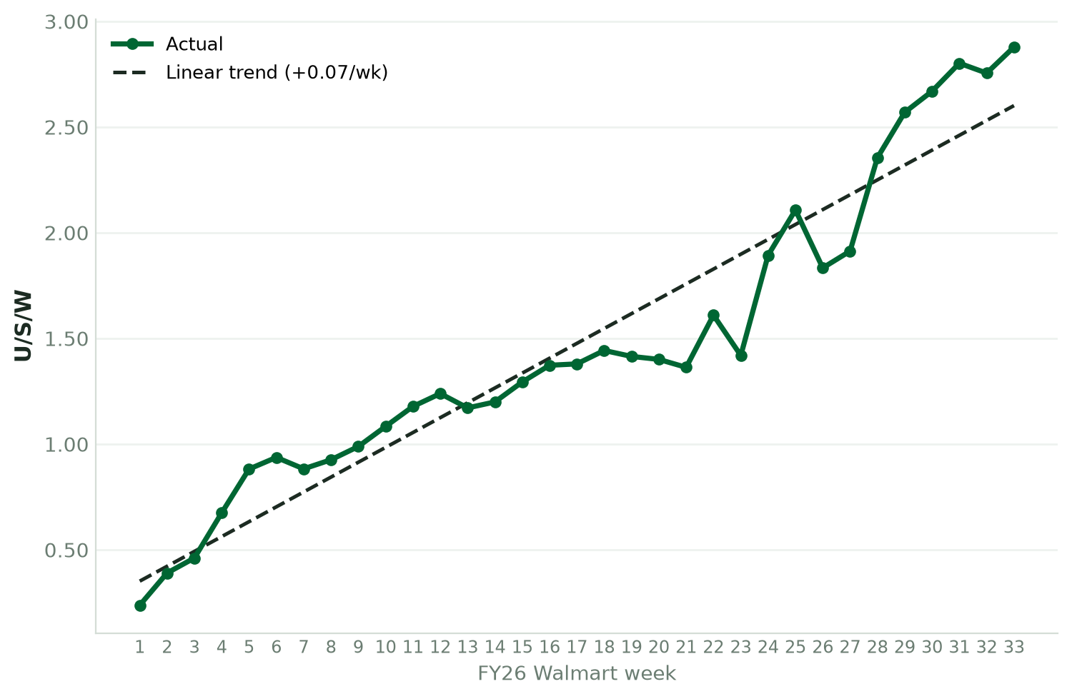
Walmart — 15 lb Original: Linear Weekly Growth
In-store units and U/S/W (units per store per week), FY26 weekly with linear trend
Linear weekly growth: +256 units/week • +0.070 U/S/W per week (Wk 1: 835 u / 0.238 → Wk 33: 10,382 u / 2.878)

